Slide 1

Runtime, Rating & Audience Count
Is there a connection?
By Christopher Ford

Slide 2


Is there a correlation between Runtime, Rating & Audience Count?
Analyzing the data -
For this test we have taken movies that are rated above 60%, have a shorter runtime then 180 minutes and have an audience count above 150,000.
We will use a pearsonr test to provide a scatterpoint and boxplot of each outcome.
Are shorter or longer horror movies more highly rated? Are shorter or longer action movies more highly rated? Is there a correlation between rating and audience count? These are the questions we will answer.

Slide 3
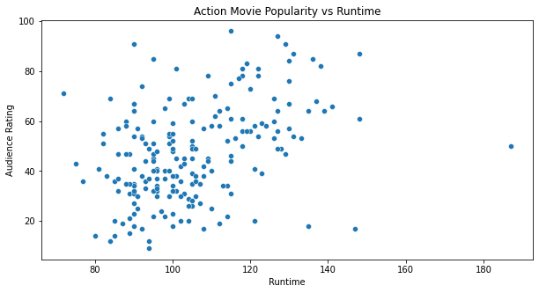
Action Movies – Runtime & Rating - Scatterpoint
Low Correlation
With this graph we can see that there is a low correlation.
After running our pearsonr test we can conclude that there is no relevant correlation between short or long action movies and their popularity. An action movie can be set at any length and be just highly rated or poorly rated.

Slide 4
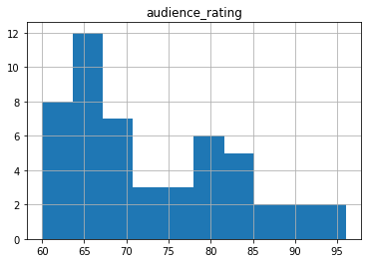
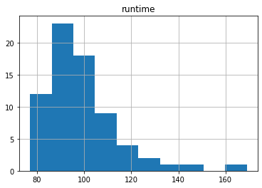
Action Movies – Runtime & Rating Boxplot
Boxplot Analysis
Continuing from the scatterpoint we now look at a boxplot of our pearsonr test.
With this graph we can see that there is a
high and low end for two variables.

Slide 5
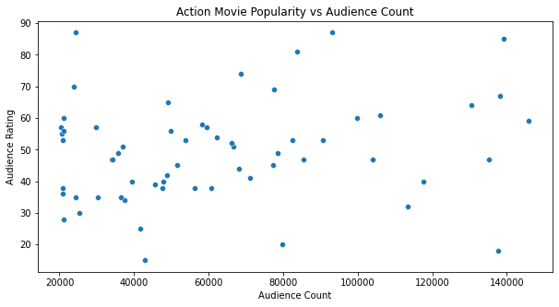
Action Movies – Audience Count & Rating - Scatterpoint
Low Correlation
With this graph we can see that there is a low correlation.
After running our pearsonr test we can conclude that there is no relevant correlation between audience rating or audience count. An action movie can poorly rated or highly rated regardless of the amount of people.

Slide 6
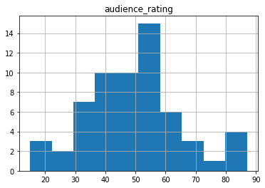
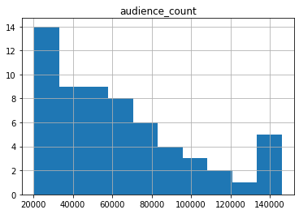
Action Movies – Audience Count & Rating Boxplot
Boxplot Analysis
Continuing from the scatterpoint we now look at a boxplot of our pearsonr test.
With this graph we can see that there is a
high and low end for two variables.

Slide 7
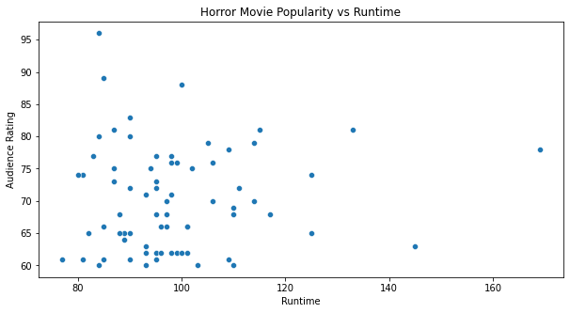
Horror Movies - Runtime & Rating - Scatterpoint
Low Correlation
With this graph we can see that there is a low correlation.
After running our pearsonr test we can conclude that there is no relevant correlation between short or long horror movies and their popularity. A horror movie can be set at any length and be just highly rated or poorly rated.

Slide 8
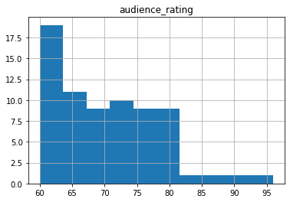
Horror Movies – Audience Count & Rating Boxplot
Boxplot Analysis
Continuing from the scatterpoint we now look at a boxplot of our pearsonr test.
With this graph we can see that there is a
high and low end for two variables.

Slide 9
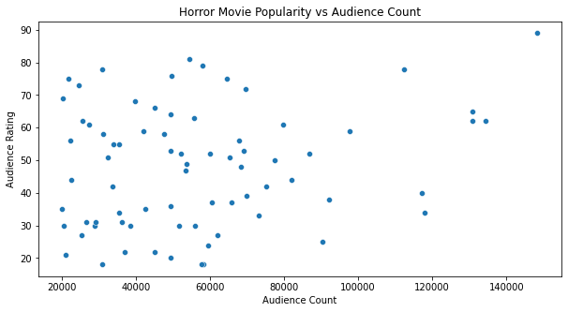
Horror Movies – Audience Count & Rating - Scatterpoint
Low Correlation
With this graph we can see that there is a low correlation.
After running our pearsonr test we can conclude that there is no relevant correlation between audience rating or audience count. A horror movie can poorly rated or highly rated regardless of the amount of people.

Slide 10
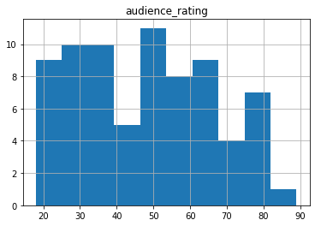
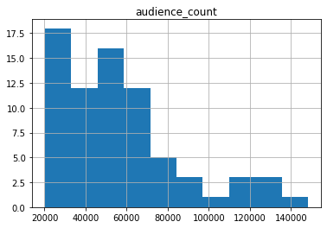
Horror Movies – Audience Count & Rating Boxplot
Boxplot Analysis
Continuing from the scatterpoint we now look at a boxplot of our pearsonr test.
With this graph we can see that there is a
high and low end for two variables.

Slide 11

Conclusion
We have tested to see if there is a correlation between movie rating and runtime. As a result, there is little to no correlation to movie rating and movie runtime. An action or horror movie can be set at any length and be poorly rated or highly rated.
We also tested to see if there was any correlation between highly rated action/horror movies and audience count, as our results show that there is little to no correlation there either.
In conclusion, if you are making a movie, you should not be concerned about the length of your movie, rating or audience count affecting each other as they share little correlation to each other

